Slide 1


Yoko Takishita
January 6, 2023

Slide 2

Outline
Executive Summary
Introduction
Methodology
Results
Conclusion
Appendix

Slide 3
Executive Summary
Summary of methodologies
Data collection
Data wrangling
Exploratory Data Analysis (EDA) with SQL
EDA with Matplotlib
Building an interactive map with Folium
Building a Dashboard with Plotly Dash
Predictive analysis
Summary of all results
Exploratory Data Analysis
Interactive analysis
Predictive analysis

Slide 4
Introduction
Project background and context
SpaceX advertises Dlacon9 rocket launches on its website with a cost of 62 million dollars, while other providers cost upward of 165 million dollars. The saving was achieved by SpaceX because Space X can reuse the first stage.
If we can predict whether the first stage can successfully land, we can determine the cost of a launch
Problems you want to find answers
What factors determine if the first stage of the rocket launch can land successfully
Build a predictive model

Slide 5

Section 1

Slide 6
Methodology
Executive Summary
Data collection methodology:
SpaceX Rest API
Web Scrapping from Wikipedia
Perform data wrangling
One Hot Encoding applied to categorical variables
Data cleaning of null values and irrelevant columns
Perform exploratory data analysis (EDA) using SQL and Matplotlib
Perform interactive visual analytics using Folium and Plotly Dash
Perform predictive analysis using classification models
LR, KNN, SVM, DT models and evaluation

Slide 7
Data Collection
SpaceX launch data was obtained from the SpaceX REST API
Falcon9 launch data was obtained by web scraping Wikipedia using BeautifulSoup
Request SpaceX REST API
Return SpaceX data in .json
Normalize data into csv file
Get HTML response from Wikipedia
Extract data using BeautifulSoup
Normalize data into csv file
Data wrangling

Slide 8
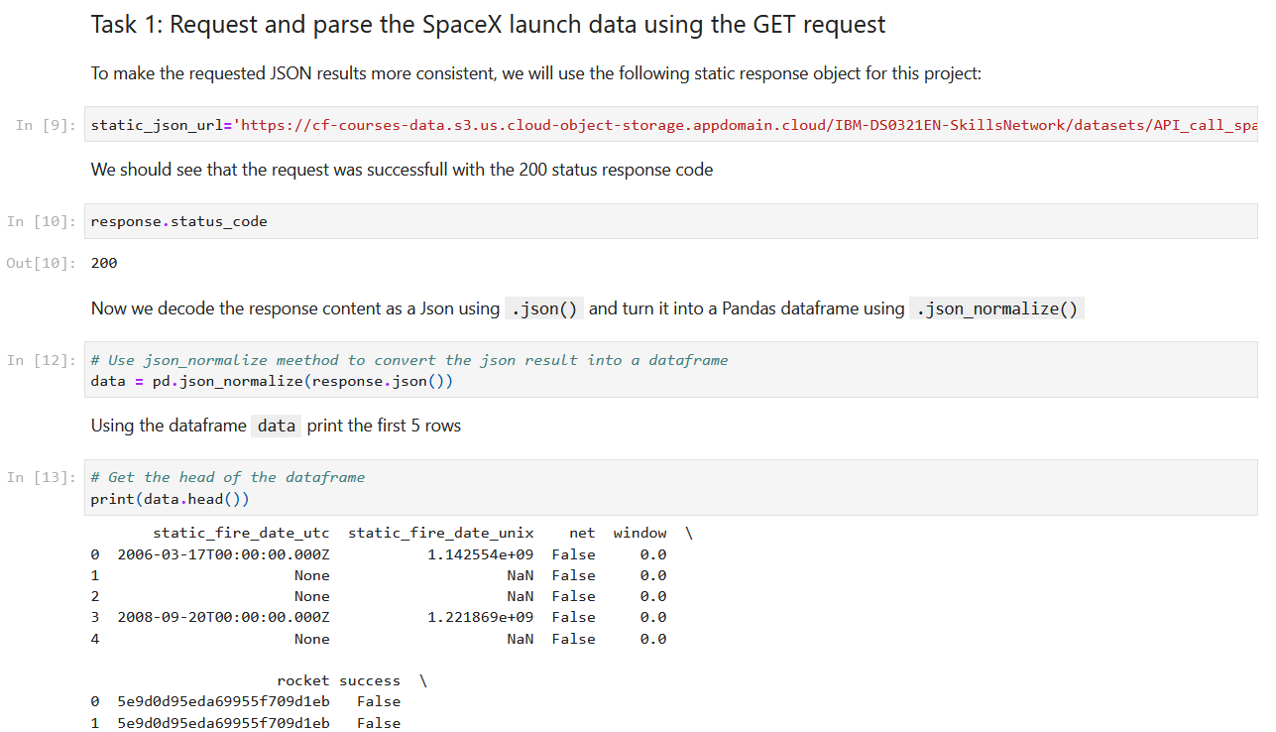
Data Collection – SpaceX API
Get request to obtain the data
Normalize by json_normalize()
https://github.com/PomuPomu8/Testrepo/blob/master/REST_API.ipynb

Slide 9
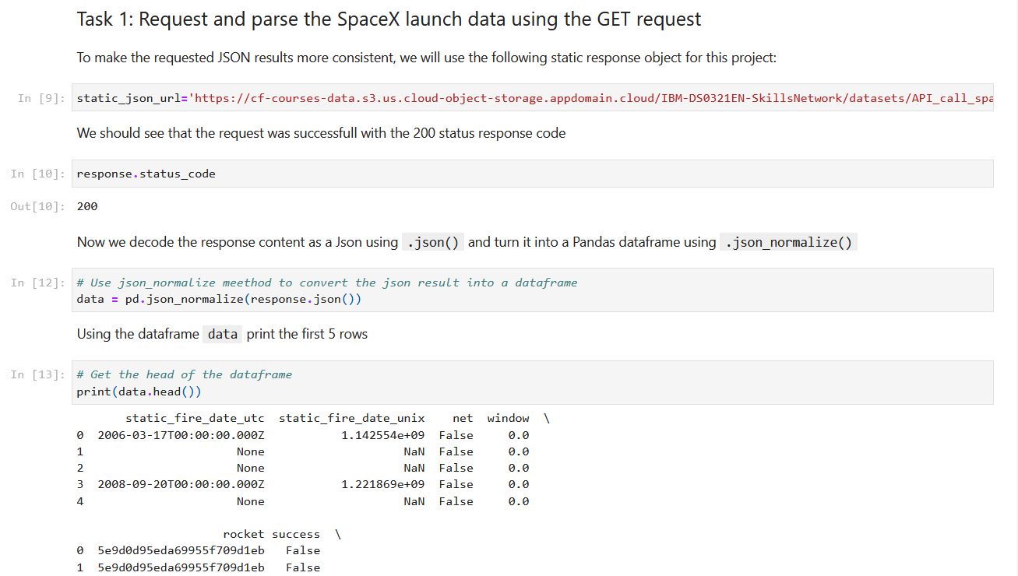
Data Collection - Scraping
Get request from HTML
Beautifulsoup
https://github.com/PomuPomu8/Testrepo/blob/master/jupyter-labs-webscraping(2).ipynb

Slide 10
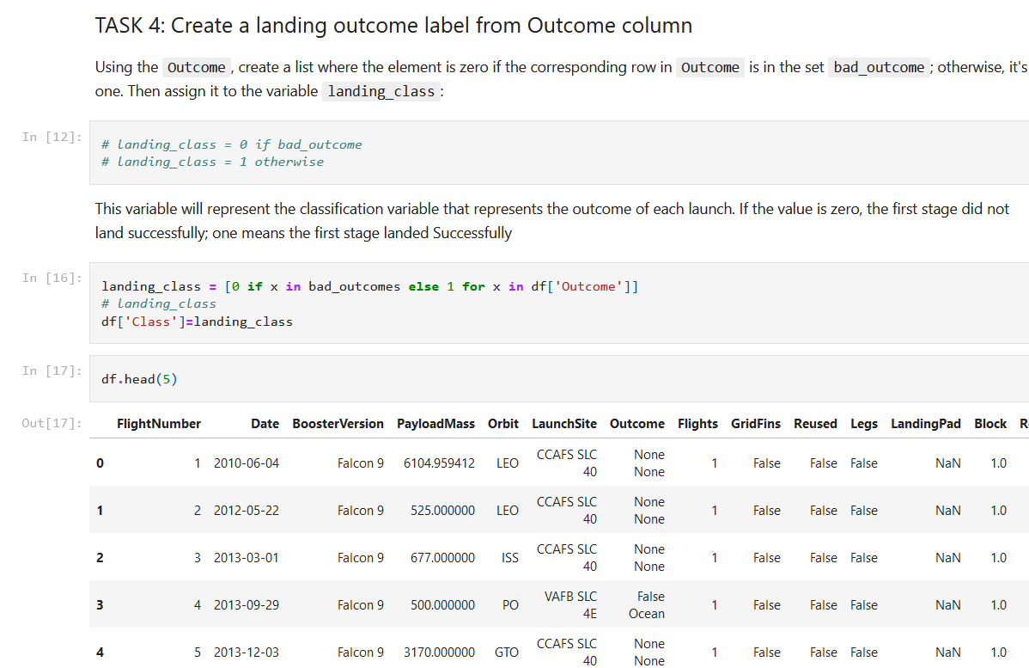
Data Wrangling
Calculate the number of launches on each site
Calculate the number and occurrence of each orbit
Calculate the number of occurrence of mission outcome per orbit type
Create a landing outcome label from outcome column
https://github.com/PomuPomu8/Testrepo/blob/master/IBM-DS0321EN-SkillsNetwork_labs_module_1_L3_labs-jupyter-spacex-data_wrangling_jupyterlite.jupyterlite.ipynb

Slide 11
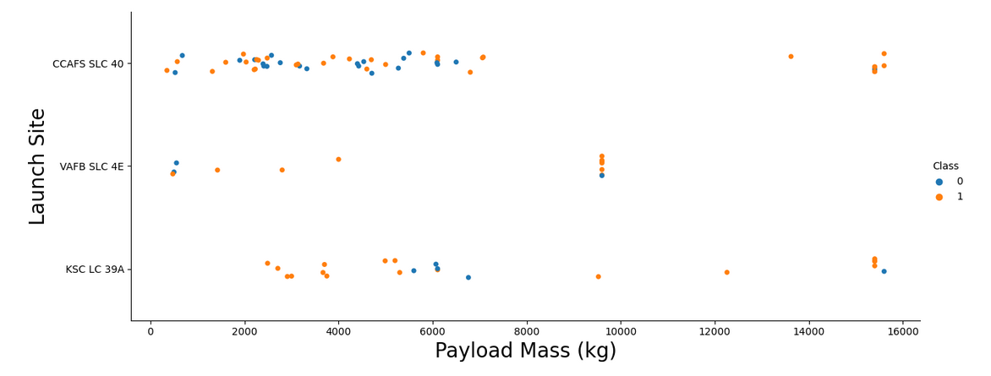
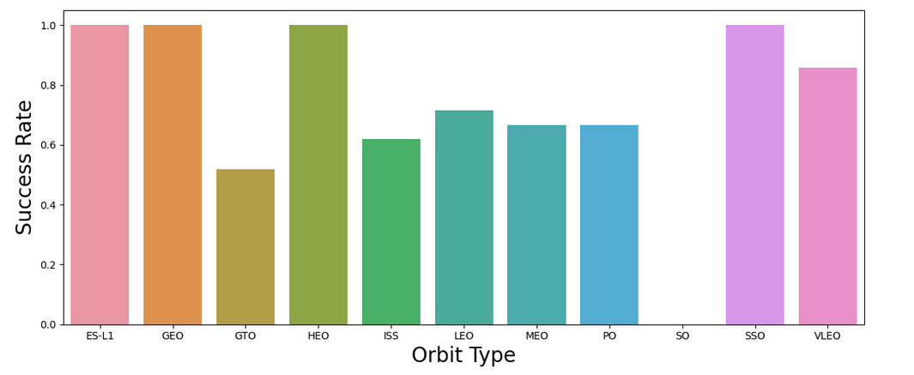
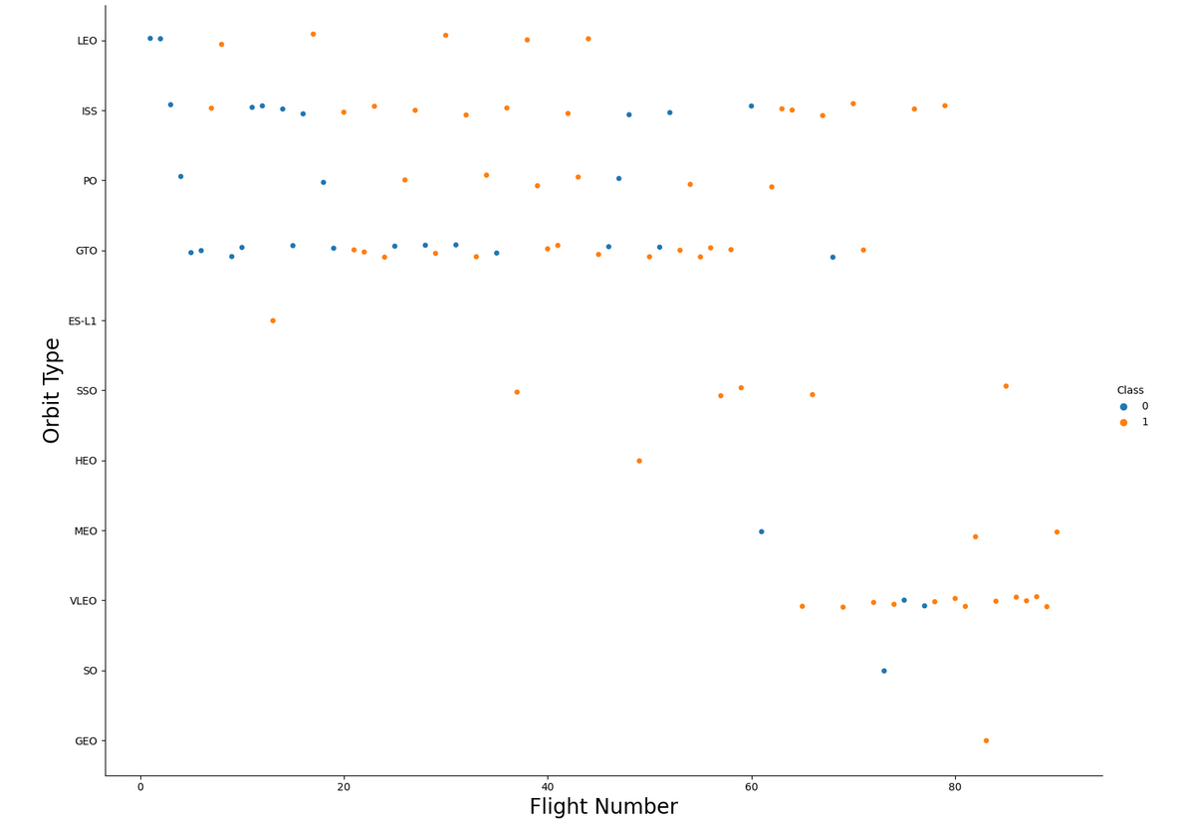
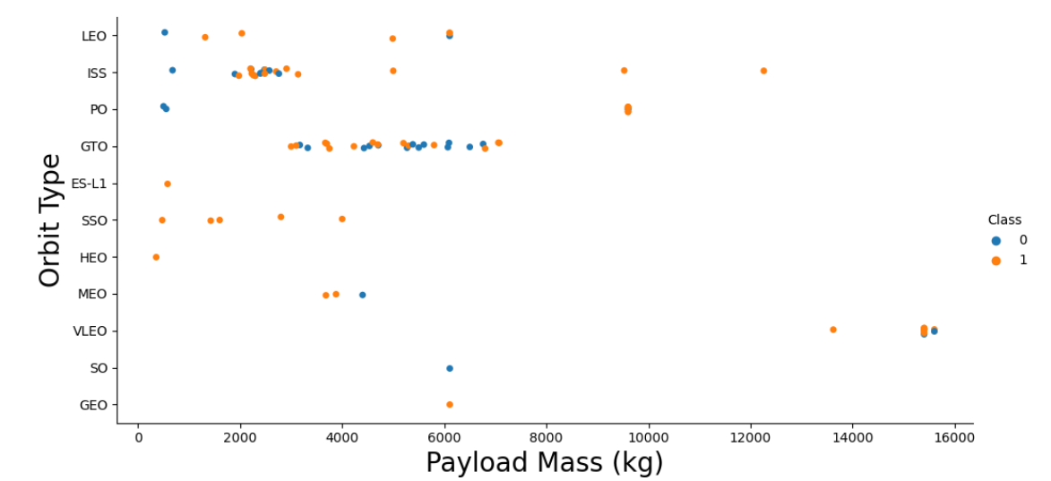
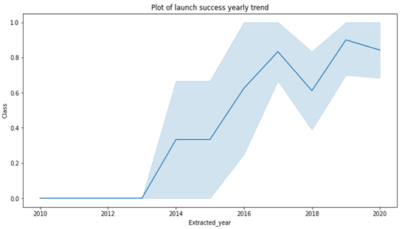
EDA with Data Visualization - Matplotlib

Slide 12
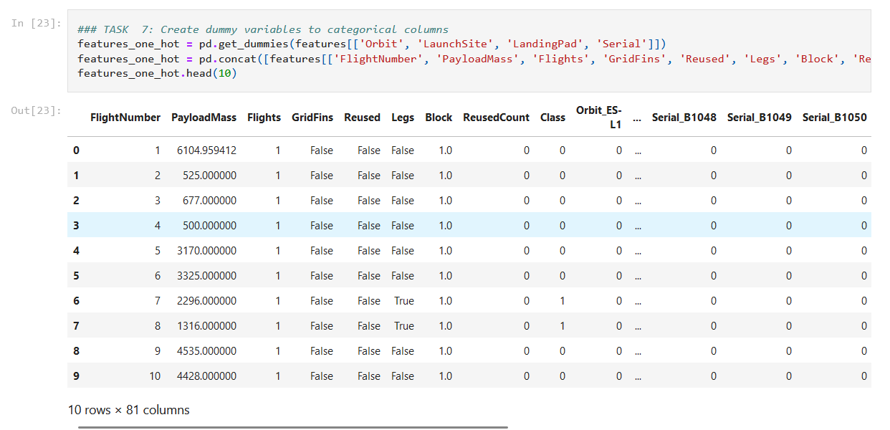
EDA with Data Visualization
Create dummy variables to categorical columns
https://github.com/PomuPomu8/Testrepo/blob/master/IBM-DS0321EN-SkillsNetwork_labs_module_2_jupyter-labs-eda-dataviz.ipynb.jupyterlite.ipynb

Slide 13
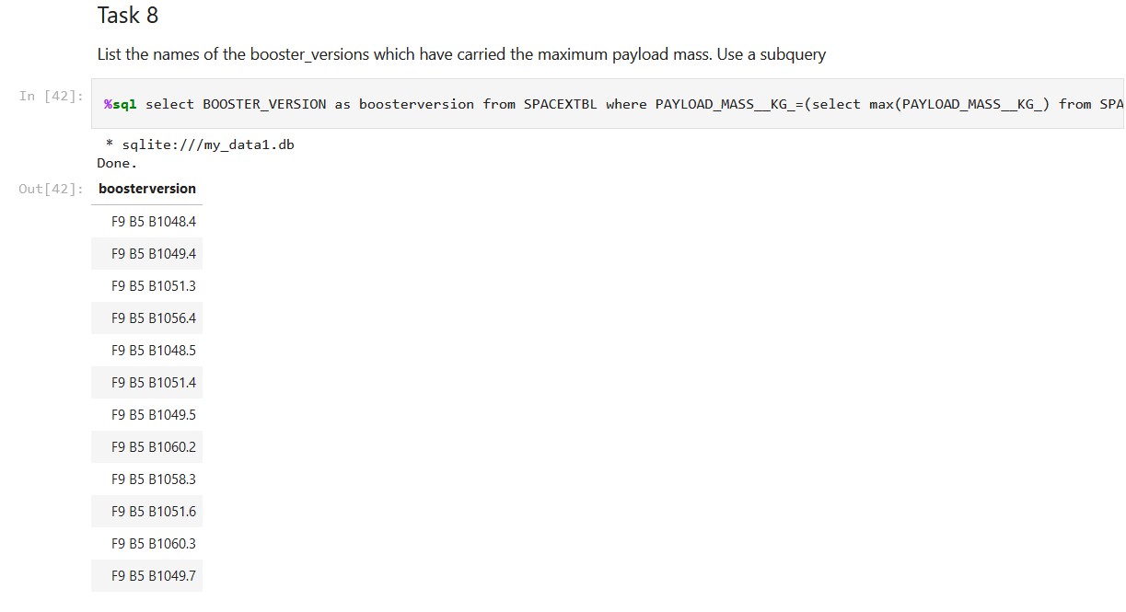
EDA with SQL
Load SpaceX data into a PostgreSQL database
SQL queries such as:
Name of unique launch sites in the space mission
Total payload mass carried by boosters launched by NASA(CRS)
Average payload mass carried by booster version F9 v1,1
Total number of successful and failure mission outcomes
https://github.com/PomuPomu8/Testrepo/blob/master/jupyter-labs-eda-sql-coursera_sqllite.ipynb

Slide 14
Build an Interactive Map with Folium
Marked all launch sites, and added map objects to mark the success or failure of launches for each site
Create a cluster map to find the locations with high landing sucess
Calculate the distances between a launch site to its proximities:
Are launch sites near railways, highways and coastlines?
Do launch sites keep distance away from cities?
https://github.com/PomuPomu8/Testrepo/blob/master/IBM-DS0321EN-SkillsNetwork_labs_module_3_lab_jupyter_launch_site_location.jupyterlite.ipynb

Slide 15
Build a Interactive Dashboard with Plotly Dash
Interactive dashboard with Plotly dash
Dropdown list: 'Select a launch site here'
Plot pie charts showing the total launches by each site
Plot scatter graph showing the relationship with outcome and payload mass for the different booster version
https://github.com/PomuPomu8/Testrepo/blob/master/spacex_dash_app.py

Slide 16
Predictive Analysis (Classification)
Create Numpyarray
Split the data into training and testing sets (20%)
Different models:
Logistic regression
SVM
Decision trree
KNN
Evaluation by GridSearchCV
Determine the best model by highest accuracy (R2 score)
https://github.com/PomuPomu8/Testrepo/blob/master/IBM-DS0321EN-SkillsNetwork_labs_module_4_SpaceX_Machine_Learning_Prediction_Part_5.jupyterlite.ipynb

Slide 17
Results
Logistic regression, SVM and KNN models were the best in terms of accuracy
Lower payload mass performed better, compared to heavier payload
The success of SpaceX launch has been increasing since 2013
Orbit GEP, HEO, SSO, ED L2 gave best success rate.
KSL LC 39A was the highest success rate

Slide 18

Section 2

Slide 19
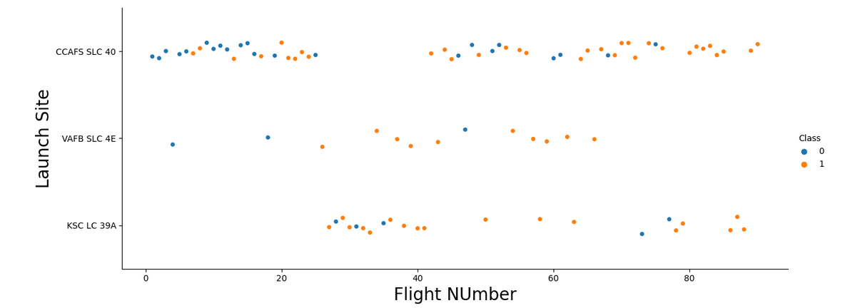
Flight Number vs. Launch Site
For CCAFS SLC 40 site, higher flight numbers have better success rate.

Slide 20
Payload vs. Launch Site
For CCAFS SLC 40, heavier payload mass had better success rate

Slide 21
Success Rate vs. Orbit Type
ES-L1, GEO, HEO, SSO, VLEO had the best success rate

Slide 22
Flight Number vs. Orbit Type
For VLEO, higher flight number had more success
For GTP, there seemed no relationship between success rate and flight number

Slide 23
Payload vs. Orbit Type
PO. LEO and ISS orbits are used with heavierr payload mass

Slide 24
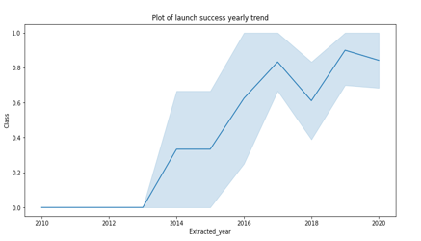
Launch Success Yearly Trend
Success of SpaceX launch has been increasing since 2013

Slide 25
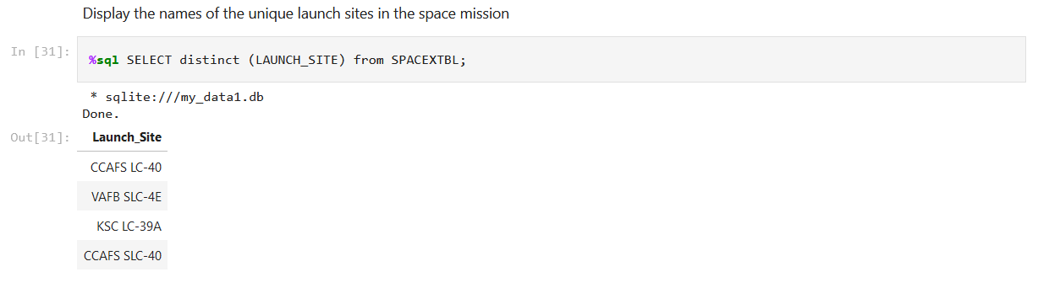
All Launch Site Names
Used DISTINCT clause to show unique launch sites

Slide 26
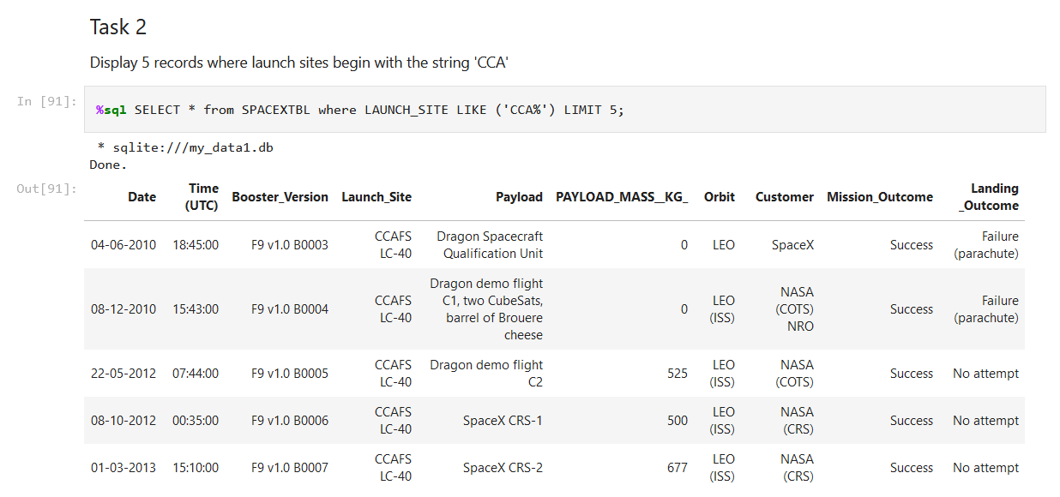
Launch Site Names Begin with 'CCA'
Found 5 records where launch sites begin with `CCA`, using WHERE, LIKE and LIMIT clauses

Slide 27
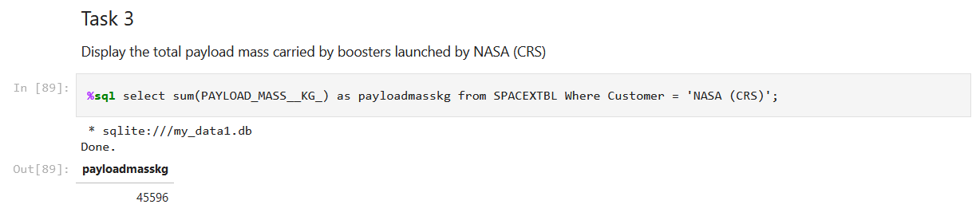
Total Payload Mass
Calculated the total payload mass = 45596 kg

Slide 28
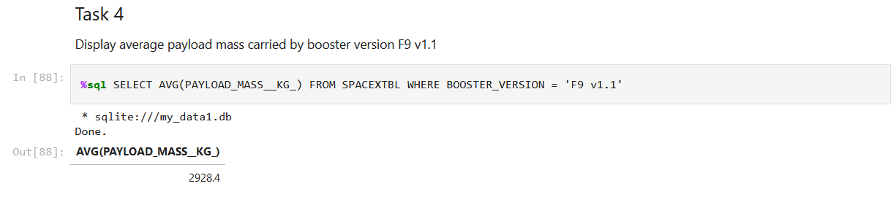
Average Payload Mass by F9 v1.1
Calculated the average payload mass carried by booster version F9 v1.1 = 2928.4 kg

Slide 29
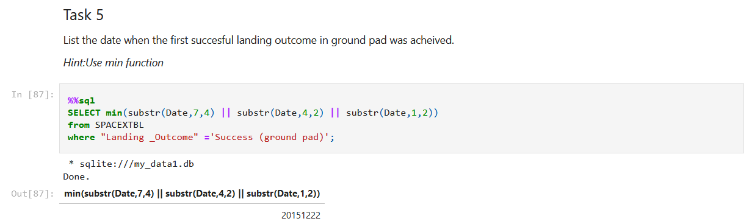
First Successful Ground Landing Date
Found the dates of the first successful landing outcome on ground pad
= December 22, 2015

Slide 30
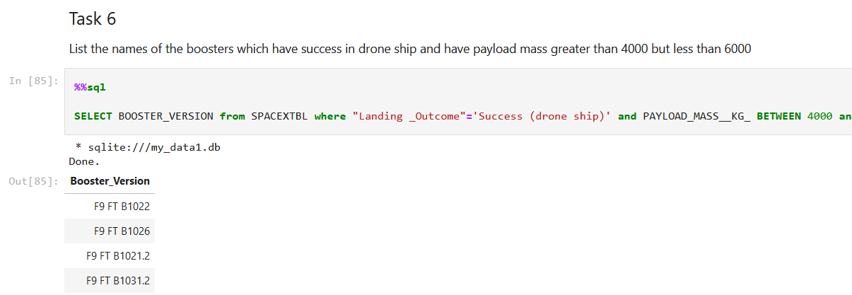
Successful Drone Ship Landing with Payload between 4000 and 6000
List the names of boosters which have successfully landed on drone ship and had payload mass greater than 4000 but less than 6000, using AND and BETWEEN clauses

Slide 31
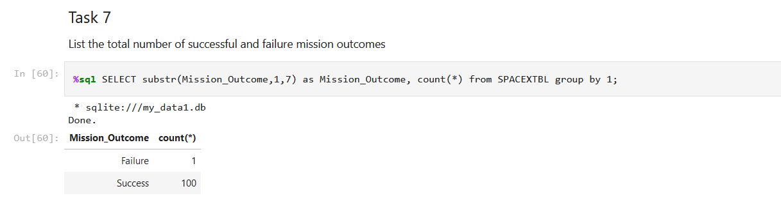
Total Number of Successful and Failure Mission Outcomes
Total number of successful and failure mission outcomes
= Success: 100, Failure: 0

Slide 32
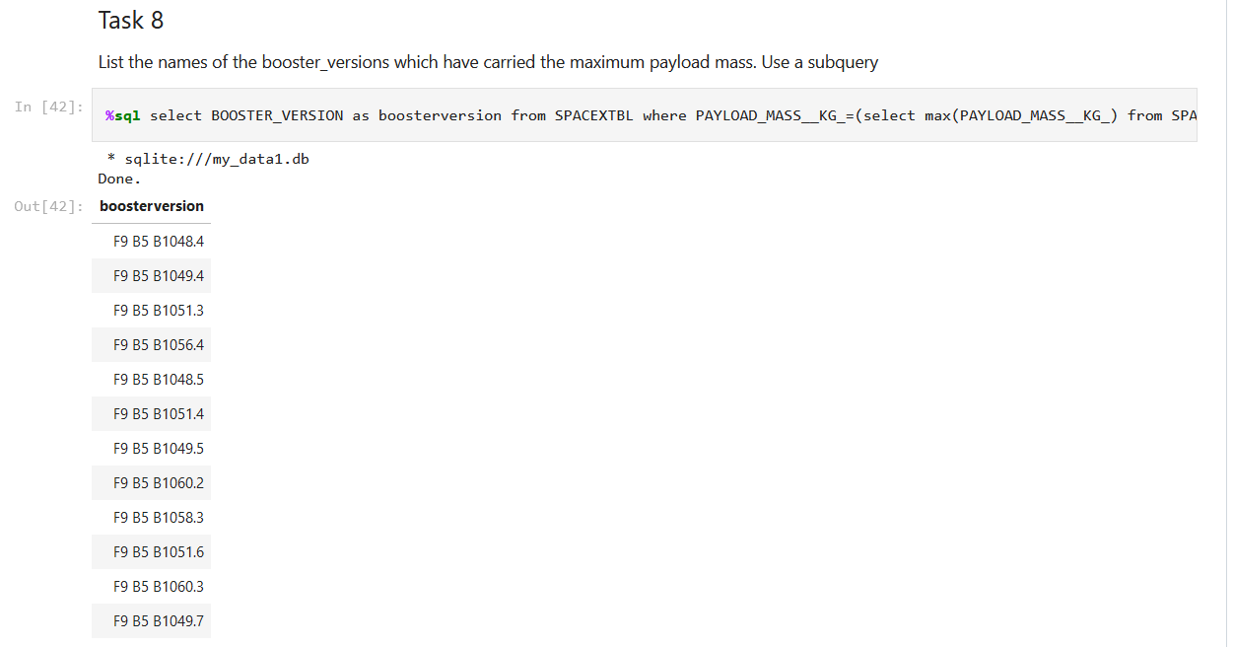
Boosters Carried Maximum Payload
Listed the names of the booster which have carried the maximum payload mass, using MAX clause

Slide 33
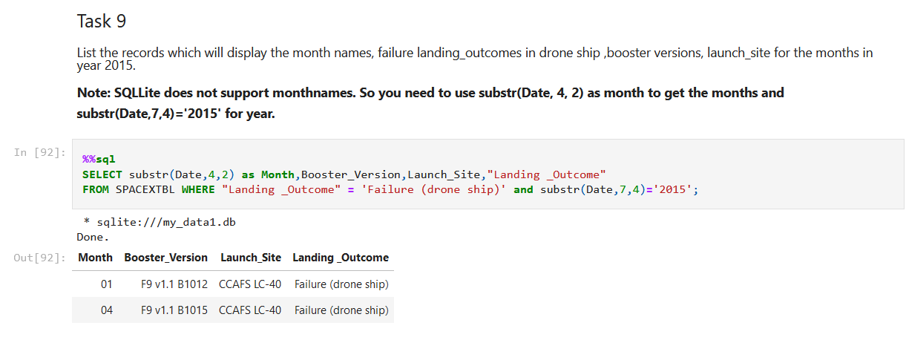
2015 Launch Records
Listed the failed landing_outcomes in drone ship, their booster versions, and launch site names for in year 2015, using WHERE, AND clauses, and substr()

Slide 34
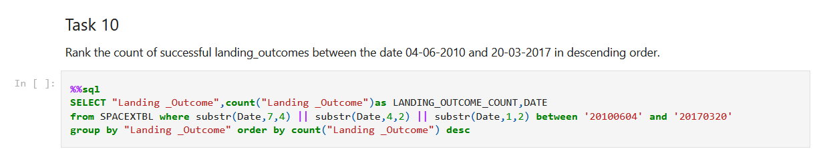
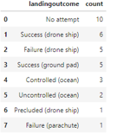
Rank Landing Outcomes Between 2010-06-04 and 2017-03-20
Ranked landing outcomes between the date 2010-06-04 and 2017-03-20, in descending order, using GROUP BY and ORDERED BY clauses

Slide 35

Section 3

Slide 36
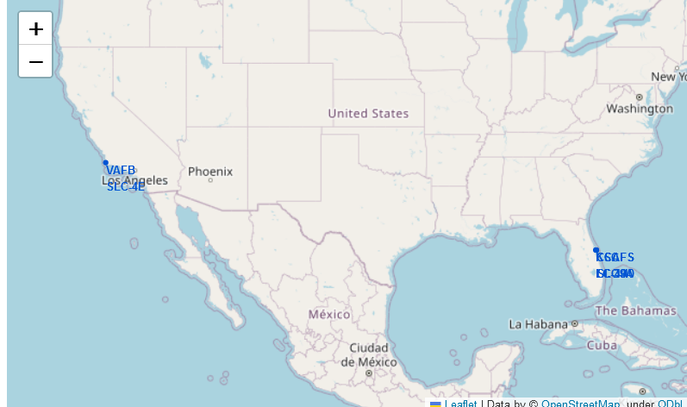
All launch sites marked on a global map
Launch sites are coastal areas in California and Florida

Slide 37
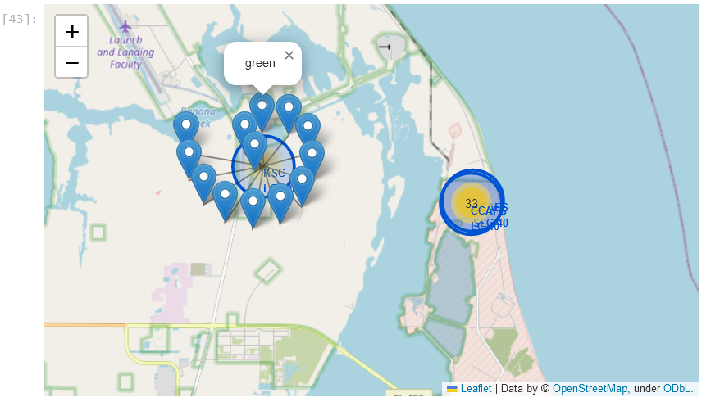
Success/failed launches marked on the map
Cluster marker showed sites with higher success

Slide 38
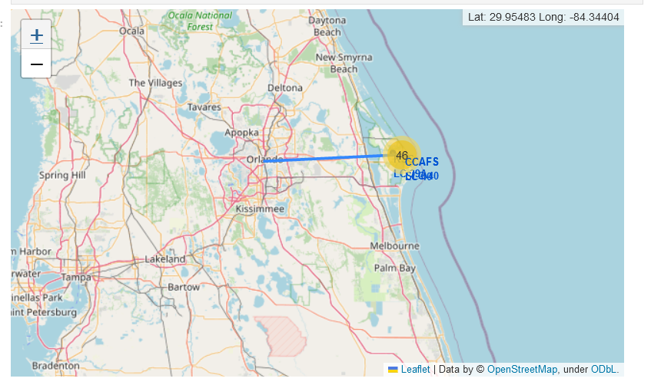
Distances between launch site to its proximites
Distance from the launch site to Orlando city

Slide 39

Section 4

Slide 40
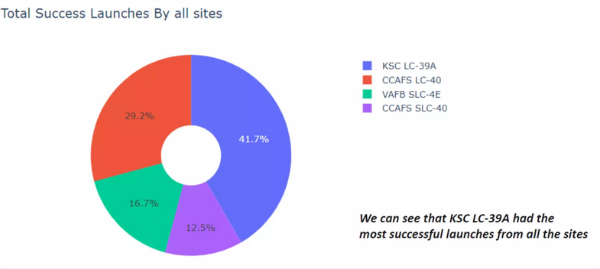
Total success by each launch sites
KSC LC-39A had the most successful launches among all the sites

Slide 41
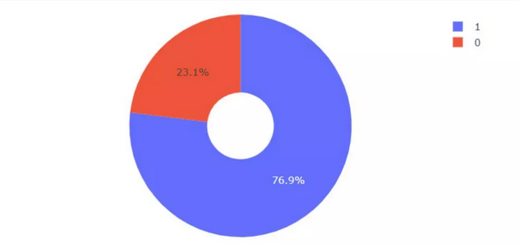
Succes rate by sites KSC LC-39A
KSC LC-39A success rate was 76.9 %

Slide 42
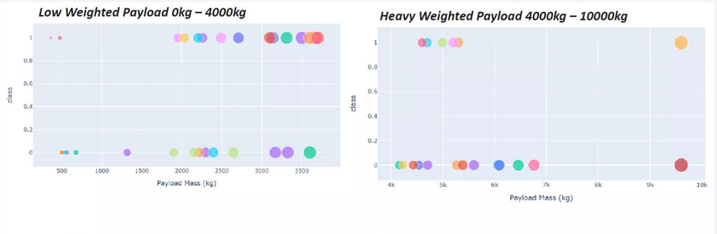
Payload vs Launch outcome for all sites, ranging different payload masses
Lighter payload performed better, compared to heavier payload mass

Slide 43

Section 5

Slide 44
Classification Accuracy
Used GridSearch to identify best parameters
Accuracy score was calculated for the test data
Logistc regression, SVM and KNN models performed better, compared to Decision Tree model

Slide 45
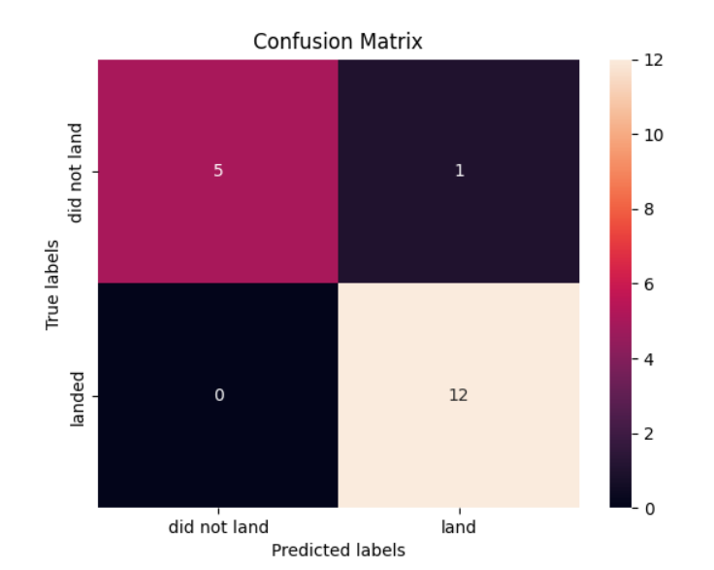
Confusion Matrix
Logistic regression distinguished between the different classes
Major problem is false positives (i.e. unsuccessful landings marked as successful)

Slide 46
Conclusions
Logistic regression, SVM and KNN models were the best in terms of accuracy
Lower payload mass performed better, compared to heavier payload
The success of SpaceX launch has been increasing since 2013
Orbit GEP, HEO, SSO, ED L2 gave best success rate.
KSL LC 39A was the highest success rate

Slide 47
Appendix- list of Github links for Juoyter notebooks
Data collection – REST API | https://github.com/PomuPomu8/Testrepo/blob/master/REST_API.ipynb
Data collection – Web scraping | https://github.com/PomuPomu8/Testrepo/blob/master/jupyter-labs-webscraping(2).ipynb
Data wrangling | https://github.com/PomuPomu8/Testrepo/blob/master/IBM-DS0321EN-SkillsNetwork_labs_module_1_L3_labs-jupyter-spacex-data_wrangling_jupyterlite.jupyterlite.ipynb
Exploratory Data Analysis - SQL | https://github.com/PomuPomu8/Testrepo/blob/master/jupyter-labs-eda-sql-coursera_sqllite.ipynb
Exploratory Data Analysis - Matplotlib | https://github.com/PomuPomu8/Testrepo/blob/master/IBM-DS0321EN-SkillsNetwork_labs_module_2_jupyter-labs-eda-dataviz.ipynb.jupyterlite.ipynb
Data visualization – Plotly Dash | https://github.com/PomuPomu8/Testrepo/blob/master/spacex_dash_app.py
Data visualization - Folium | https://github.com/PomuPomu8/Testrepo/blob/master/IBM-DS0321EN-SkillsNetwork_labs_module_3_lab_jupyter_launch_site_location.jupyterlite.ipynb
Predictive analysis – classification model | https://github.com/PomuPomu8/Testrepo/blob/master/IBM-DS0321EN-SkillsNetwork_labs_module_4_SpaceX_Machine_Learning_Prediction_Part_5.jupyterlite.ipynb

Slide 48


